Slide 1
LENDING CLUB CASE STUDY ASSIGNMENT SUBMISSION
Group Facilitator Name – Aditya Gupta
Group Members –
Aditya Gupta
Ankit Mahajan

Slide 2
Abstract
Objective: You work for a consumer finance company which specialises in lending various types of loans to urban customers. When the company receives a loan application, the company has to make a decision for loan approval based on the applicant’s profile. Two types of risks are associated with the bank’s decision:
If the applicant is likely to repay the loan, then not approving the loan results in a loss of business to the company
If the applicant is not likely to repay the loan, i.e. he/she is likely to default, then approving the loan may lead to a financial loss for the company

Slide 3
Problem Solving Methodology
Understanding Dataset
Clean Data
Data Preparation
Univariate Analysis
Clean Data
Segmented Univariate Analysis
Bivariate Analysis
Summarize Results

Slide 4
Problem solving methodology
Data Understanding:
Converting the column to correct datatype
Identifying the target column
Data Cleaning:
Finding the percentage of missing columns, removing all the columns with 100% missing values
Columns with less percentage of missing values are handled by removing the rows with missing values as the percentage is less so removing them won’t impact the data quantity.
Filtering rows – removing the rows with loan_status = ‘Current’
Standardization of columns - Required columns were changed to datetime and float
Created new columns
int_rate – perform the binning of the column int_rate to group the rate of interest of loan to low, medium and high.
annual_income_grouping – perform the binning of the annual income of employees to low, medium, high
dti_Cat – performed the binning of the column dti to low and high dtio ratio
profitOrloss –
Credit_score – calculated the credit score of loan buyers

Slide 5
Problem solving methodology
Data Analysis: There are three types of variables
Application variables – Variables that are captured during the loan application and are related to loan applicant.
e.g- occupation, employee_experience.
These type of variables are useful for the analysis.
Loan Variable – Variables which are generated during the process of applying the loan application.
e.g. int_rate, loan_amount.
These variables are required for the analysis
C. Loan Behaviour variable – These variables are generated after the loan is verified.
e.g. – mths_since_last_delinq , mths_since_last_record etc.
These variables are not required for the analysis and they can be removed from the data set.

Slide 6
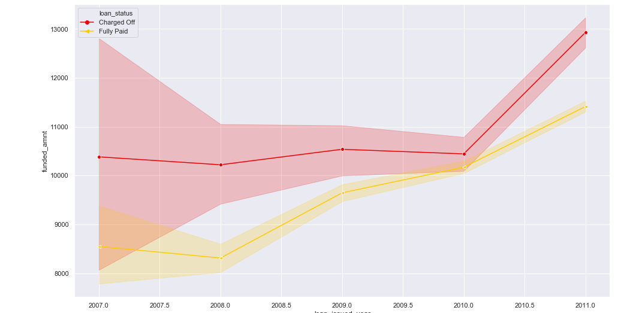
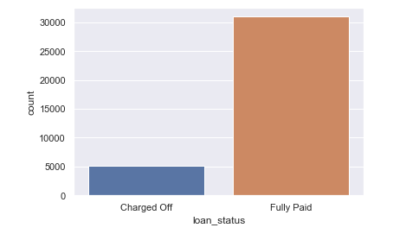
Analysis: Loan Status
Observations:
Most of the loans are Fully Paid.
In year 2011 defaulters increased exponentially .

Slide 7
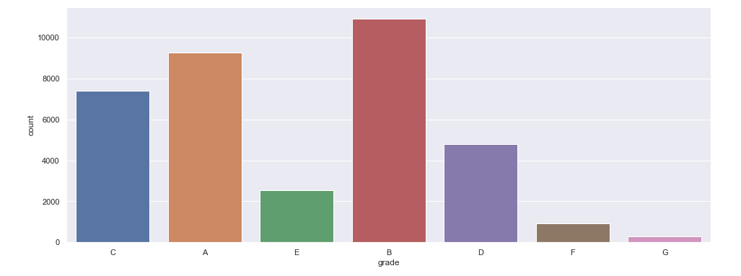
Analysis: Loan Grade
Observation:
Most of the loans have grade of A and B. Therefore stating most of the loans are high graded loans.

Slide 8
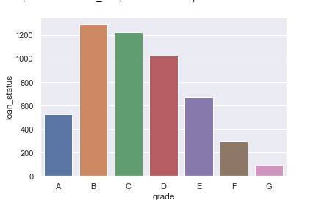
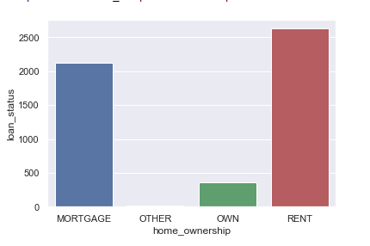
Analysis - Univariate Variables
Employees with Grade B are most likely to default .
2) People with Rented accommodation are most likely
to default.

Slide 9
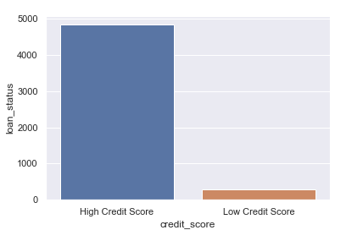
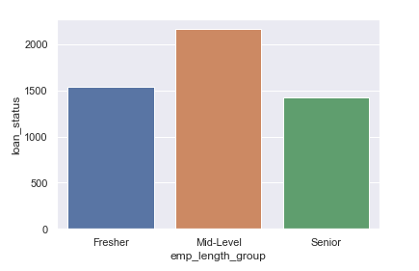
Analysis - Univariate Analysis.
3) People with high credit score are most likely to default
4) Mid Level Experience employees with experience
in the range 2 years to 8 years are most likely to default

Slide 10
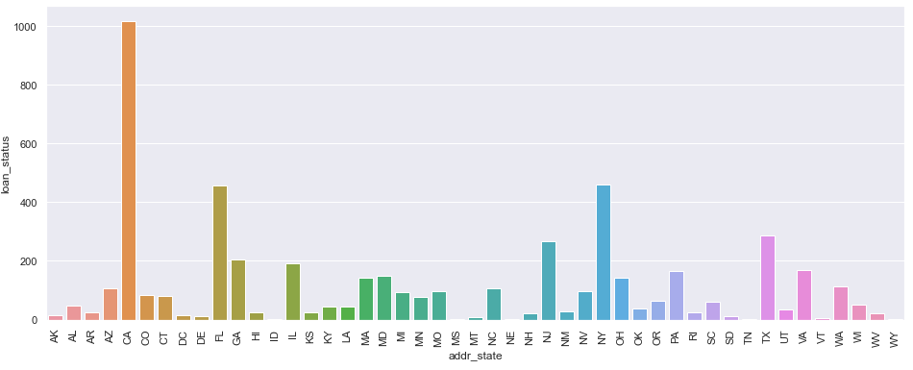
Analysis - Univariate Analysis
5) Number of most defaulters are from CA state

Slide 11
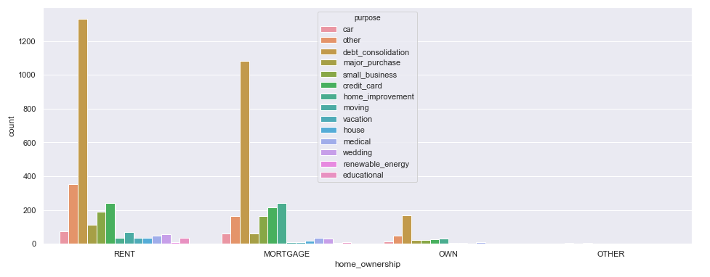
Analysis: Bivariate Variable
Observation:
Most people with rented accommodation and debt consolidation as purpose of loan are most likely to default

Slide 12
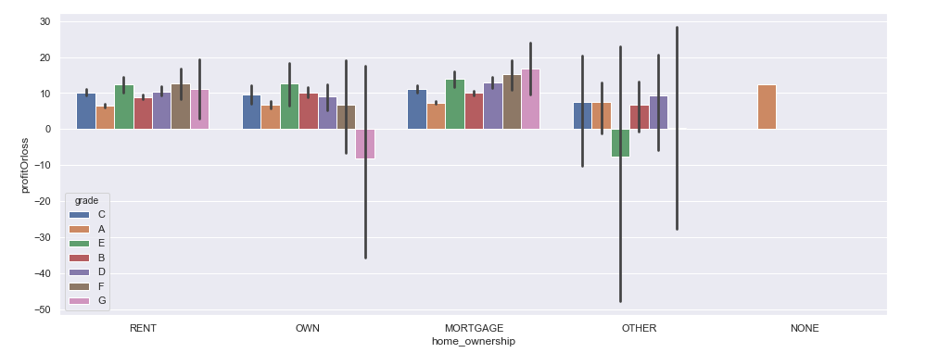
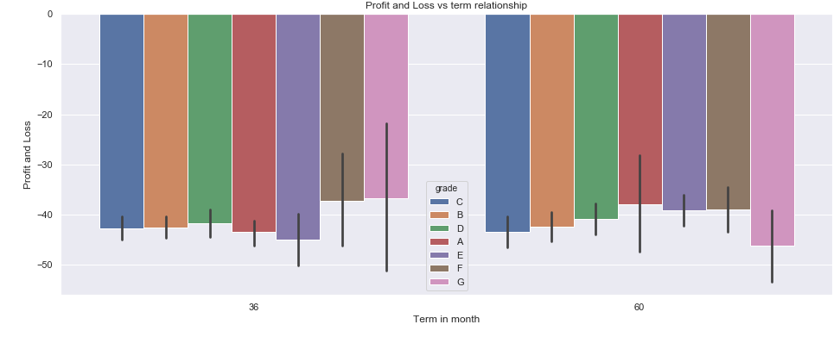
Analysis: Bivariate Variable
Observation:
Most of the loss occurs by home owners and other
Most of the profit occurs by mortgage holders

Slide 13
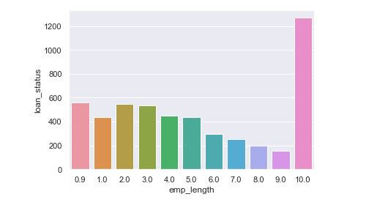
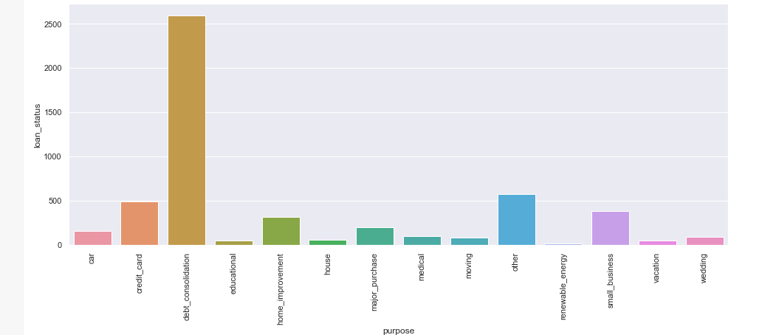
Analysis: Bivariate Variable
Observation:
Applicants having more experience tends to default the loan.
Most of the loans are granted were for debt consolidation

Slide 14
Conclusions
Low grade loans have high tendency to default. Grading system is working as expected
Applicants with Rented Accommodation are most likely to default.
Loans having higher interest rate have more defaulters. Check the background of applicant thoroughly if interest rate is high.
Applicants bellowing to CA state are most likely to default.
Applicants with 10+ years of experience are more likely to default.
Applicants who have taken loan for purpose as debt consolidation are more likely to default.
Loan application with medium int rate, rate in range 8 to 15 are more likely to default.
Loan applicants with low salary, salary in range 4K – 200K are most likely to default.

